Slide 1
CSIT988/CSIT488 Security, Ethics and Professionalism Week 5: Information Security Policy
Subject Coordinator: Guangyou Zhou
Central China Normal University
Spring 2024

Slide 2
Week | Lecture Topics | Readings
1 | Introduction and overview of the subject | Chapter 1 / No Tutorials
2 | Information security management | Chapter 1
3 | Planning for security | Chapter 2
4 | Planning for contingencies | Chapter 3
5 | Information security policy | Chapter 4
6 | Developing the security program | Chapter 5
7 | Security management models & practices | Chapter 6, 7
8 | Risk management: identifying and accessing risk | Chapter 8
9 | Risk management: controlling risk | Chapter 9
10 | Protection mechanisms | Chapter 10
11 | Personnel and security | Chapter 11
12 | Law and Ethics | Chapter 12
13 | Exam Review
Notes:
Fundamentals of Contingency Planning (cont’d.)
Business impact analysis (BIA)
- A preparatory activity common to both CP and Risk Management
- Determines which functions and information systems are the most critical to the success of the organization
Incident response planning (IRP)
Focuses on immediate response
Disaster recovery planning (DRP)
Focuses on restoring operations at the primary site after disasters occur
Business continuity planning (BCP)
Facilitates establishment of operations at an alternate site, until the organization is able to resume operations at its primary site or select a new primary location

Slide 3
LEARNING OBJECTIVES
Define information security policy and understand its central role in a successful information security program
Describe the three major types of information security policy and discuss the major components of each
Discuss the process of developing, implementing, and maintaining various types of information security policies
Notes:
Types of information security policy
Enterprise information security program policy (EISP)
Issue-specific information security policies (ISSP)
Systems-specific policies (SysSP)

Slide 4
LEARNING OBJECTIVES
Types of information security policy
Enterprise information security program policy (EISP)
Issue-specific information security policies (ISSP)
Systems-specific policies (SysSP)
Notes:
Types of information security policy
Enterprise information security program policy (EISP)
Issue-specific information security policies (ISSP)
Systems-specific policies (SysSP)

Slide 5
Introduction
Policy is the essential foundation of an effective information security program
“The success of an information resources protection program depends on the policy generated, and on the attitude of management toward securing information on automated systems”
Policy maker sets the tone and emphasis on the importance of information security

Slide 6
Introduction (cont’d.)
Policy objectives
Reduced risk
Compliance with laws and regulations
Assurance of operational continuity, information integrity, and confidentiality

Slide 7
Why Policy?
A quality information security program begins and ends with policy
Policies are the least expensive means of control and often the most difficult to implement
Basic rules for shaping a policy
Policy should never conflict with law
Policy must be able to stand up in court if challenged
Policy must be properly supported and administered

Slide 8
Why Policy? (cont’d.)
One implementation model that emphasizes the role of policy in an InfoSec program is the bull’s-eye model.
It provides a proven mechanism for prioritizing complex changes, the bull’s-eye model has become widely accepted among InfoSec professionals.
In this model, issues are addressed by moving from the general to the specific, always starting with policy.
That is, the focus is on systemic solutions instead of individual problems.

Slide 9
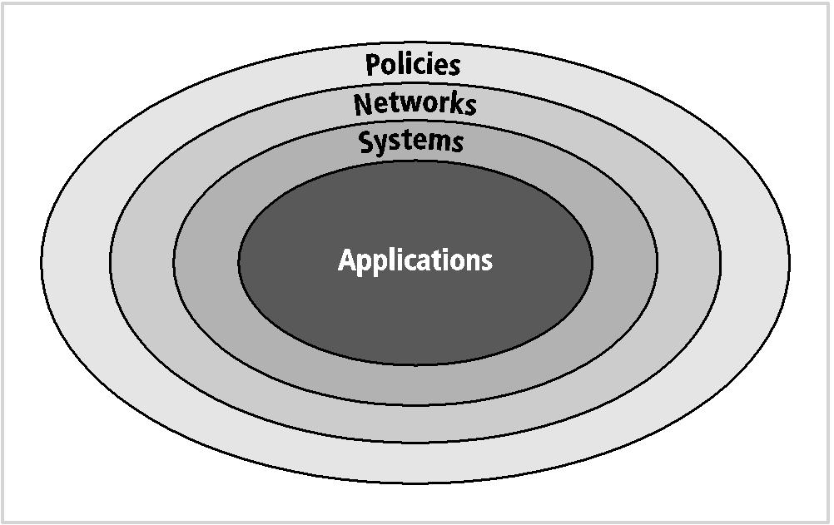
Why Policy? (cont’d.)
Notes:
Whether via the use of the bull’s-eye model or any other methodology, until sound and usable IT and InfoSec policy is developed, communicated, and enforced, no additional resources should be spent on controls.

Slide 10
Why Policy? (cont’d.)
Bulls-eye model layers
Policies: outer layer; initial viewpoint for most InfoSec system users; available from published documents
Networks: the environment where threats first meet the organization’s network
Systems: collections of hardware and software, process control and manufacturing systems
Applications: all applications systems

Slide 11
Why Policy? (cont’d.)
Policies are important reference documents
For internal audits
For the resolution of legal disputes about management's due diligence
Policy documents can act as a clear statement of management's intent

Slide 12
Policy, Standards, and Practices
Policy
A plan or course of action that influences decisions
For policies to be effective they must be properly disseminated, read, understood, agreed-to, and uniformly enforced
Policies require constant modification and maintenance
Types of information security policy
Enterprise information security program policy (EISP)
Issue-specific information security policies (ISSP)
Systems-specific policies (SysSP)
Notes:
The communities of interest described in previous chapters use policy to express their views regarding the security environment of the organization.
Policies should not specify the proper operation of equipment or software—this information should be placed in other documenta- tion called “standards,” “procedures,” “practices,” and “guidelines.”

Slide 13
Policy, Standards, and Practices
The communities of interest described in previous chapters use policy to express their views regarding the security environment of the organization.
Policies should not specify the proper operation of equipment or software—this information should be placed in other documentation called “standards,” “procedures,” “practices,” and “guidelines.”
Notes:
The communities of interest described in previous chapters use policy to express their views regarding the security environment of the organization.
Policies should not specify the proper operation of equipment or software—this information should be placed in other documenta- tion called “standards,” “procedures,” “practices,” and “guidelines.”

Slide 14
Policy, Standards, and Practices (cont’d.)
Standards
A more detailed statement of what must be done to comply with policy
Practices
Procedures and guidelines explain how employees will comply with policy
Notes:
Policies must also specify the penalties for unacceptable behavior and define an appeals process. For example, an organization that prohibits the viewing of inappropriate Web sites at the work- place must implement a set of standards that clarifies and defines exactly what it means by “inappropriate,” and what the organization will do to stop the behavior. A standard is a more detailed statement of what must be done to comply with policy. In the implementation of an inappropriate-use policy, the organization might create a standard that all inappropriate content will be blocked and then list the material that is considered inappropriate.

Slide 15
Policy, Standards, and Practices (cont’d.)
Policies must also specify the penalties for unacceptable behavior and define an appeals process. For example, an organization that prohibits the viewing of inappropriate Web sites at the workplace must implement a set of standards that clarifies and defines exactly what it means by “inappropriate,” and what the organization will do to stop the behavior.
A standard is a more detailed statement of what must be done to comply with policy. In the implementation of an inappropriate-use policy, the organization might create a standard that all inappropriate content will be blocked and then list the material that is considered inappropriate.
Notes:
Policies must also specify the penalties for unacceptable behavior and define an appeals process. For example, an organization that prohibits the viewing of inappropriate Web sites at the work- place must implement a set of standards that clarifies and defines exactly what it means by “inappropriate,” and what the organization will do to stop the behavior. A standard is a more detailed statement of what must be done to comply with policy. In the implementation of an inappropriate-use policy, the organization might create a standard that all inappropriate content will be blocked and then list the material that is considered inappropriate.

Slide 16
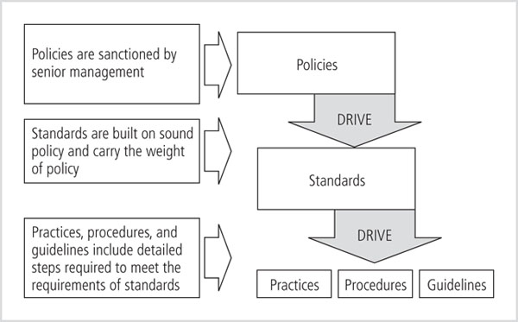
Policies, Standards, & Practices

Slide 17
Enterprise Information Security Policy (EISP)
Sets strategic direction, scope, and tone for organization’s security efforts
Assigns responsibilities for various areas of information security
Guides development, implementation, and management requirements of information security program

Slide 18
EISP Elements
EISP documents should provide:
An overview of the corporate philosophy on security
Information about information security organization and information security roles
Responsibilities for security that are shared by all members of the organization
Responsibilities for security that are unique to each role within the organization

Slide 19
Example EISP Components
Statement of purpose
What the policy is for
Information technology security elements
Defines information security
Need for information technology security
Justifies importance of information security in the organization
Information technology security responsibilities and roles
Defines organizational structure
Reference to other information technology standards and guidelines

Slide 20
Issue-Specific Security Policy (ISSP)
Provides detailed, targeted guidance
Instructs the organization in secure use of a resource, such as technology systems
Begins with introduction to fundamental resource-use philosophy of the organization
Protects both the employee and organization from inefficiency and ambiguity
Establishes a common understanding on what resources can or cannot use
Indemnifies the organization against liability for an employee’s inappropriate or illegal system use

Slide 21
Issue-Specific Security Policy (cont’d.)
Every organization’s ISSP has three characteristics:
Address specific technology-based resources
Require frequent updates
Contain an issue statement on the organization’s position on an issue

Slide 22
Issue-Specific Security Policy (cont’d.)
Typical ISSP topics
Email and internet use
Minimum system configurations
Prohibitions against hacking
Home use of company-owned computer equipment
Use of personal equipment on company networks
Use of telecommunications technologies
Use of photocopy equipment

Slide 23
Components of the ISSP
Statement of Purpose
Authorized uses
Prohibited uses
System management
Violations of policy
Policy review and modification
Limitations of liability

Slide 24
Components of the ISSP
Statement of Purpose
Scope and applicability (what purpose)
Definition of technology addressed (what technology)
Responsibilities (who response)
Authorized Access and Usage of Equipment
User access (who can use)
Fair and responsible use (legal issues)
Specifically defines some selective use of company resources

Slide 25
Components of the ISSP (cont’d.)
Prohibited Usage of Equipment
Disruptive use or misuse
Criminal use
Offensive or harassing materials
Copyrighted, licensed or other intellectual property
Other restrictions

Slide 26
Components of the ISSP (cont’d.)
Systems management
Focuses on the users’ relationships to system management
Specifies users’ and systems administrators'’ responsibilities
Violations of policy
Penalties for violations
Procedures for reporting violations
Anonymous submission are often used

Slide 27
Components of the ISSP (cont’d.)
Policy review and modification
Scheduled review of policy and procedures for modification
Limitations of liability
Statements of liability or disclaimers
The company is not liable for employee’s individual actions

Slide 28
Implementing the ISSP
Common approaches
Several independent ISSP documents
A single comprehensive ISSP document
A modular ISSP document that unifies policy creation and administration
The recommended approach is the modular policy
Provides a balance between issue orientation and policy management

Slide 29
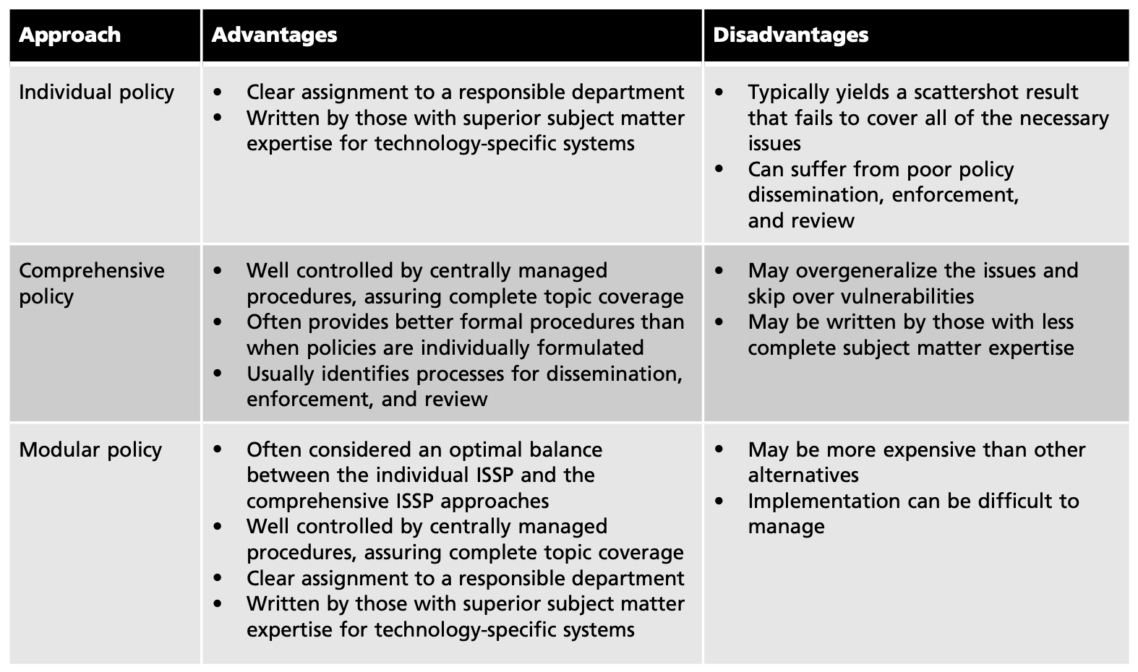
Implementing the ISSP

Slide 30
System-Specific Security Policy
System-specific security policies (SysSPs) frequently do not look like other types of policy
They may function as standards or procedures to be used when configuring or maintaining systems
SysSPs can be separated into
Management guidance
Technical specifications
Or combined in a single policy document

Slide 31
Managerial Guidance SysSPs
Created by management to guide the implementation and configuration of technology
Applies to any technology that affects the confidentiality, integrity or availability of information
Informs technologists of management intent

Slide 32
Technical Specifications SysSPs
System administrators’ directions on implementing managerial policy
Each type of equipment has its own type of policies
General methods of implementing technical controls
Access control lists
Configuration rules

Slide 33
Technical Specifications SysSPs (cont’d.)
Access control lists (ACLs)
Include the user access lists, matrices, and capability tables that govern the rights and privileges
A similar method that specifies which subjects and objects users or groups can access (capability table)
These specifications are frequently complex matrices, rather than simple lists or tables
Enable administrations to restrict access according to user, computer, time, duration, or even a particular file

Slide 34
Technical Specifications SysSPs (cont’d.)
Access control lists regulate
Who can use the system
What authorized users can access
When authorized users can access the system
Where authorized users can access the system from
How authorized users can access the system
Restricting what users can access, e.g. printers, files, communications, and applications
Administrators set user privileges
Read, write, create, modify, delete, compare, copy

Slide 35
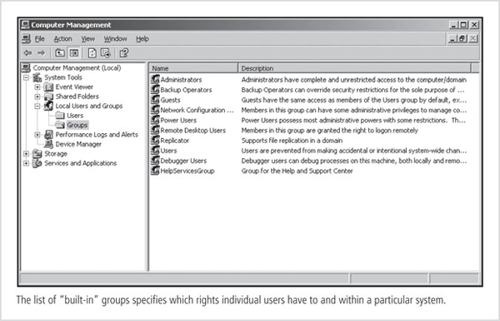
Technical Specifications SysSPs (cont’d.)

Slide 36
Technical Specifications SysSPs (cont’d.)
Configuration rules
Specific configuration codes entered into security systems
Guide the execution of the system when information is passing through it
Rule policies are more specific to system operation than ACLs
May or may not deal with users directly
Many security systems require specific configuration scripts telling the systems what actions to perform on each set of information they process

Slide 37
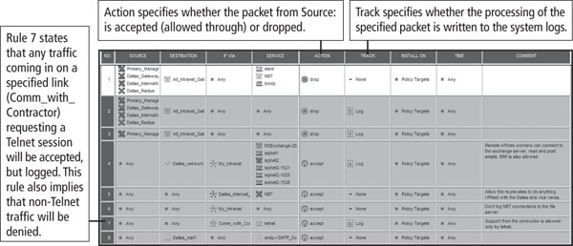
Technical Specifications SysSPs (cont’d.)
Figure 4-6 Firewall configuration rules
Notes:
Telnet is an application protocol used on the Internet or local area network to provide a bidirectional interactive text-oriented communication facility using a virtual terminal connection.

Slide 38
Technical Specifications SysSPs (cont’d.)
Often organizations create a single document combining elements of both management guidance and technical specifications SysSPs
This can be confusing, but practical
Care should be taken to articulate the required actions carefully as the procedures are presented

Slide 39
Guidelines for Effective Policy
For policies to be effective, they must be properly:
Developed using industry-accepted practices
Distributed or disseminated using all appropriate methods
Reviewed or read by all employees
Understood by all employees
Formally agreed to by act or assertion
Uniformly applied and enforced

Slide 40
Developing Information Security Policy
It is often useful to view policy development as a two-part project
First, design and develop the policy (or redesign and rewrite an outdated policy)
Second, establish management processes to perpetuate the policy within the organization
The former is an exercise in project management, while the latter requires adherence to good business practices

Slide 41
Developing Information Security Policy (cont’d.)
Policy development projects should be
Well planned
Properly funded
Aggressively managed to ensure that it is completed on time and within budget
The policy development project can be guided by the SecSDLC process
Investigation, analysis, design, implementation, maintenance

Slide 42
Developing Information Security Policy (cont’d.)
Investigation phase
Obtain support from senior management, and active involvement of IT management, specifically the CIO
Clearly articulate the goals of the policy project
Gain participation of correct individuals affected by the recommended policies
Involve legal, human resources and end-users
Assign a project champion with sufficient stature and prestige
Acquire a capable project manager
Develop a detailed outline of and sound estimates for project cost and scheduling

Slide 43
Developing Information Security Policy (cont’d.)
Analysis phase should produce
New or recent risk assessment or IT audit documenting the current information security needs of the organization
Key reference materials
Including any existing policies

Slide 44
Developing Information Security Policy (cont’d.)
Design phase includes
How the policies will be distributed
How verification of the distribution will be accomplished
Specifications for any automated tools
Revisions to feasibility analysis reports based on improved costs and benefits as the design is clarified

Slide 45
Developing Information Security Policy (cont’d.)
Implementation phase includes
Writing the policies
Making certain the policies are enforceable as written
Policy distribution is not always straightforward
Effective policy is written at a reasonable reading level, and attempts to minimize technical jargon and management terminology

Slide 46
Developing Information Security Policy (cont’d.)
Maintenance Phase
Maintain and modify the policy as needed to ensure that it remains effective as a tool to meet changing threats
The policy should have a built-in mechanism via which users can report problems with the policy, preferably anonymously
Periodic review should be built in to the process

Slide 47
Automated Tools
The need for effective policy management has led to the emergence of a class of software tools that supports policy development, implementation, and maintenance.
At the forefront of these tools is the VigilEnt Policy Center (VPC), a centralized policy approval and implementation system from NetIQ (www.informationshield.com/vpcmain. html). VPC allows policy developers to create policy, manage the approval process with multiple individuals or groups, and distribute approved policy throughout their organizations.
VPC assesses readers’ understanding of the policy and electronically records reader acknowledgments. Use of VPC reduces or eliminates the need to distribute hard copies of documents that might go unread and to manage multiple policy receipt acknowledgment forms.
Tools like VPC keep policies confidential, behind password-protected intranets, and generate periodic reports indicating which employees have and have not read and acknowledged the policies.
Figure 4-10 The VigilEnt policy center
Notes:
The need for effective policy management has led to the emergence of a class of software tools that supports policy development, implementation, and maintenance. At the forefront of these tools is the VigilEnt Policy Center (VPC), a centralized policy approval and implementation system from NetIQ (www.informationshield.com/vpcmain. html). VPC allows policy developers to create policy, manage the approval process with multiple individuals or groups, and distribute approved policy throughout their organiza- tions. VPC assesses readers’ understanding of the policy and electronically records reader acknowledgments. Use of VPC reduces or eliminates the need to distribute hard copies of documents that might go unread and to manage multiple policy receipt acknowledgment forms. Tools like VPC keep policies confidential, behind password-protected intranets, and generate periodic reports indicating which employees have and have not read and acknowledged the policies.

Slide 48
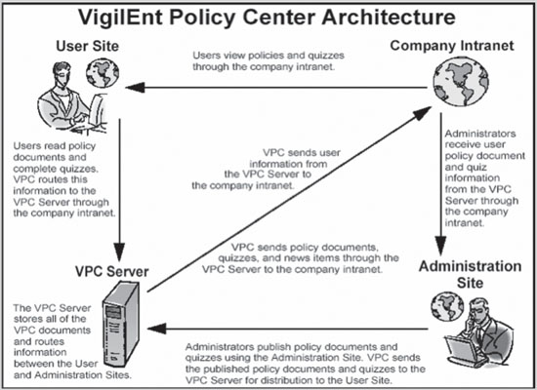
Automated Tools
Figure 4-10 The VigilEnt policy center
Notes:
The need for effective policy management has led to the emergence of a class of software tools that supports policy development, implementation, and maintenance. At the forefront of these tools is the VigilEnt Policy Center (VPC), a centralized policy approval and implementation system from NetIQ (www.informationshield.com/vpcmain. html). VPC allows policy developers to create policy, manage the approval process with multiple individuals or groups, and distribute approved policy throughout their organiza- tions. VPC assesses readers’ understanding of the policy and electronically records reader acknowledgments. Use of VPC reduces or eliminates the need to distribute hard copies of documents that might go unread and to manage multiple policy receipt acknowledgment forms. Tools like VPC keep policies confidential, behind password-protected intranets, and generate periodic reports indicating which employees have and have not read and acknowledged the policies.

Slide 49
Reference
The Information Securities Policy Made Easy Approach
SP 800-18 Rev.1: Guide for Developing Security Plans for Federal Information Systems

Slide 50
A Final Note on Policy
Lest you believe that the only reason to have policies is to avoid litigation, it is important to emphasize the preventative nature of policy
Policies exist, first and foremost, to inform employees of what is and is not acceptable behavior in the organization
Policy seeks to improve employee productivity, and prevent potentially embarrassing situations

